Slide 1
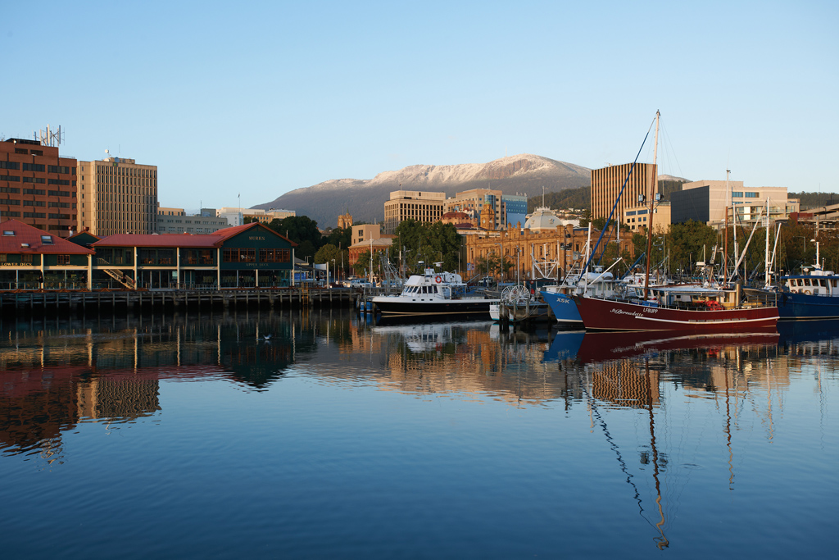
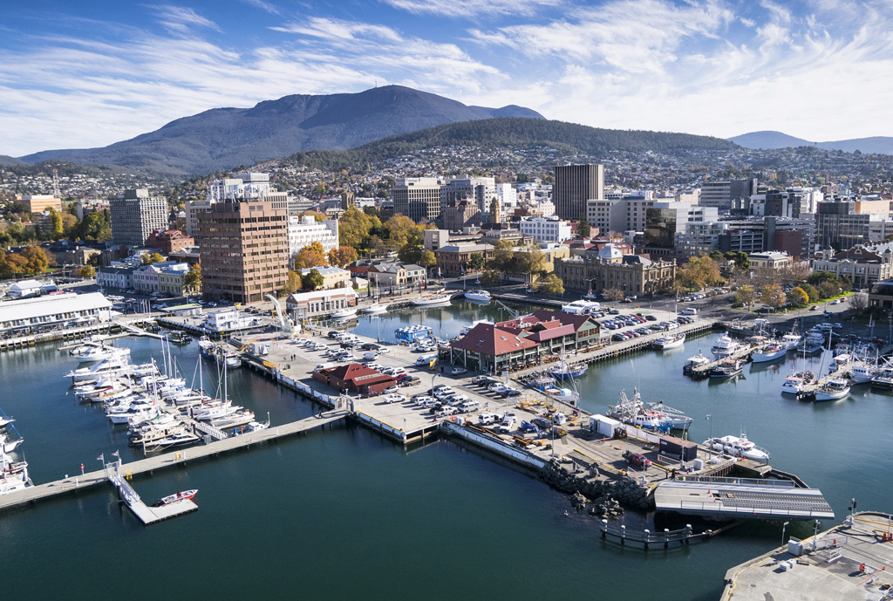
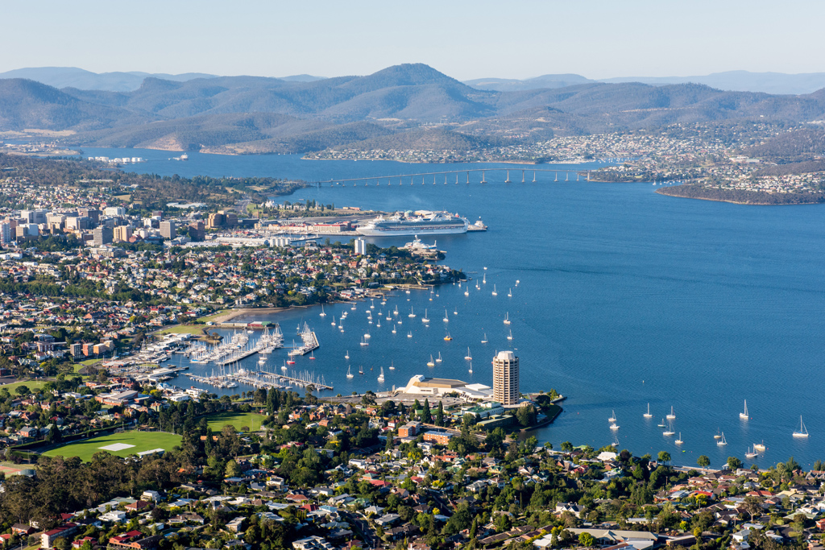
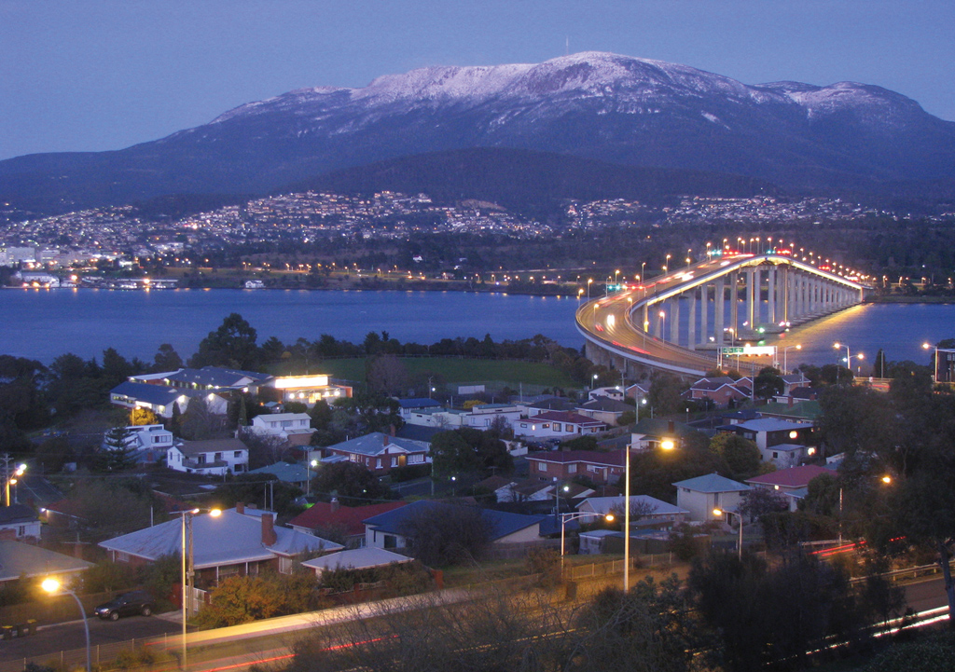
Hobart Tasmania – Sister City to Xi’An

Slide 2

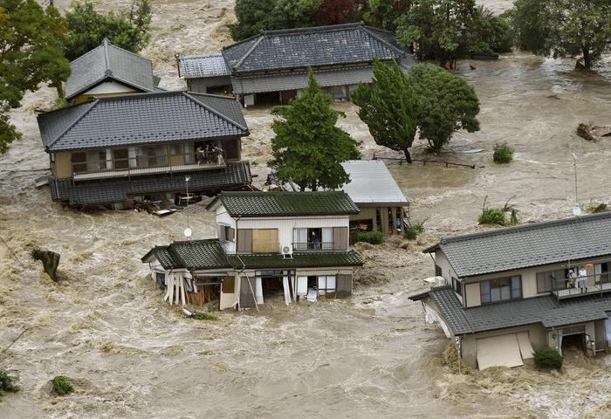
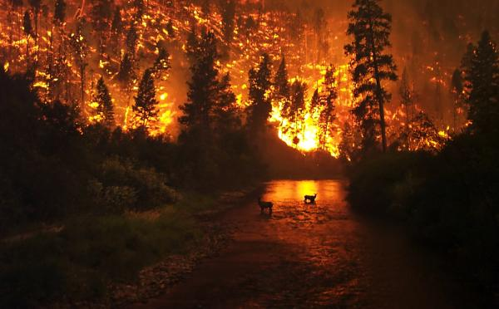
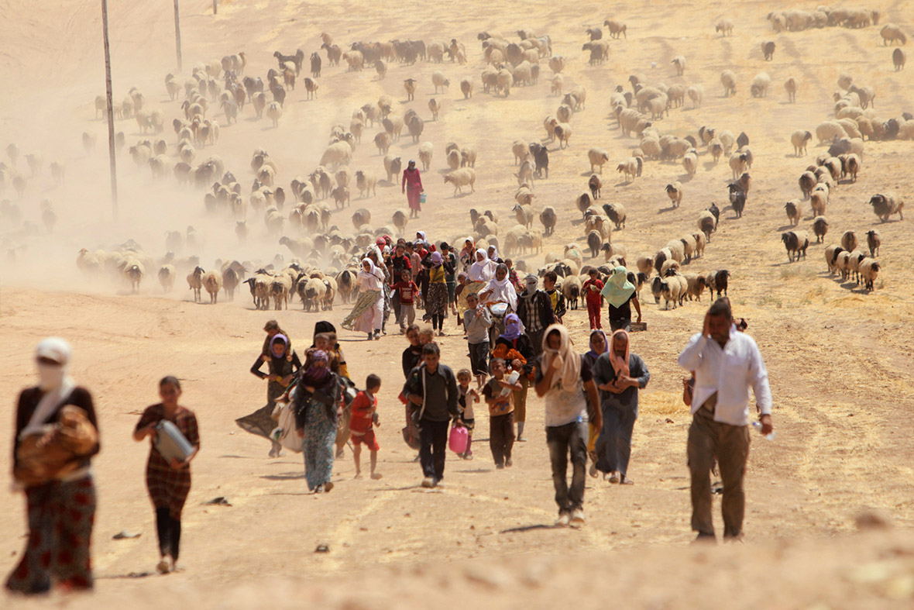
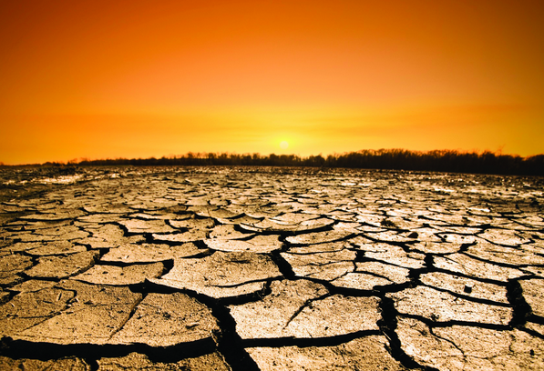
Impacts of CO₂ and other Emissions
Ocean Acidification: 1/3 of the CO₂ emitted by human activity has already been taken up by the ocean. As CO₂ dissolves in sea water , carbonic acid is formed.
Melting glaciers: cause sea level rise which further leads to more frequent coastal flooding and inundation.
Extreme weather: Droughts, floods, strong winds etc.
  An extreme heatwave in May 2015 killed 2500 people in India.
  Source: https://en.wikipedia.org/wiki/2015_Indian_heat_wave
  2.8 million people were recently evacuated with heavy floods in Japan
  A drought started the war in Syria
Source: http://www.nytimes.com/2015/03/03/science/earth/study-links-syria-conflict-to-drought-caused-by-climate-change.html?_r=0 http://news.nationalgeographic.com/news/2015/03/150302-syria-war-climate-change-drought/

Slide 3
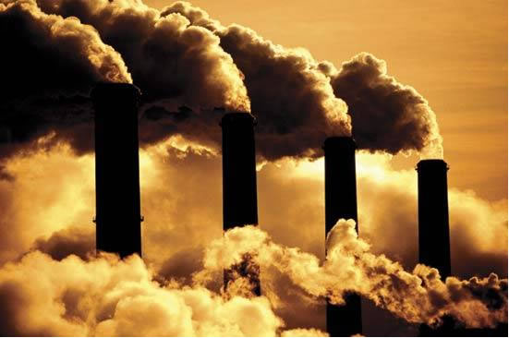
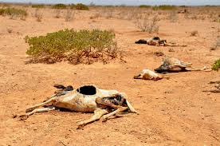
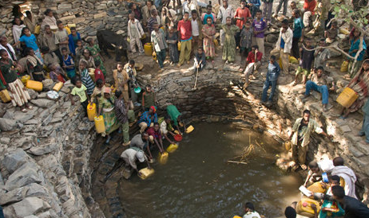
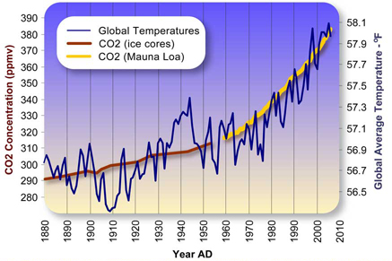


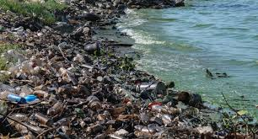


Global Problems are Interrelated

Slide 4

Global Cooperation
Spaceship earth is in trouble.
We must have better plan as the one we have is not working
it is essential we work together
and invent a more sustainable future!
危机
Wéijī
Image source: http://k12educationsystem.com/education-system-in-different-countries/

Slide 5
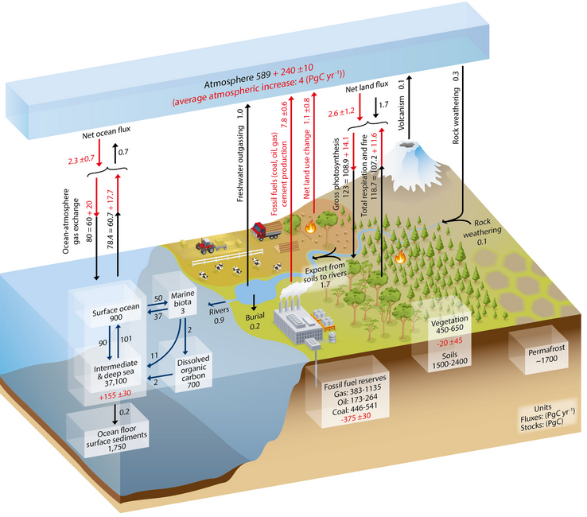
Global Carbon Flux and Sinks
Increased carbon emissions since the industrial revolution have dramatically changed the carbon cycle.
The removal of forests are responsible for approximately 1.1 GtC of carbon emissions.
Fossil fuel combustion & cement production further contribute 7.8 GtC to carbon emissions. (around 90% and 10% respectively)
The increase rate of carbon accumulating in atmosphere is 4 GtC per year, due to human activity.
In 2014 carbon emissions were at the rate of 10.9 GtC per year.
Effect of human activity in red.
GtC gigatonnes of carbon (1 GtC = (10⁹ (one billion) tonnes C = 3.67 Gt carbon dioxide)
PgC petagrams of carbon (1 PgC = 1 GtC)
Source: IPCC report on Climate Change 2013: The Physical Science Basis

Slide 6
Crustal Sinks
Carbonate sediment
40,000,000 Gt
Fossil carbonate sinks comprise in the order of 9% of the crust.
Sequestration Permanence and time
Plants 600 Gt
Soils and Detritus 2000 Gt
Fossil Fuels 8000 Gt
Methane Clathrates
100000 Gt

Slide 7
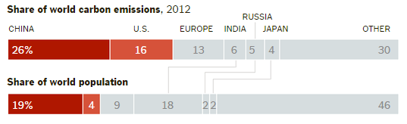
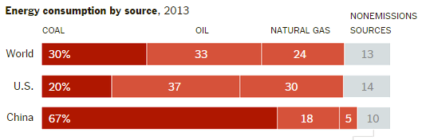
Carbon Dioxide in China Compared to the World
China is the world largest carbon dioxide emitter because:
It has the largest population in the world.
The Chinese economy relies heavily on coal.
Carbon dioxide is produced when coal is burned and is responsible for global warming and airborne particulates.
Source: BP Statistical Review of World Energy, June 2014

Slide 8
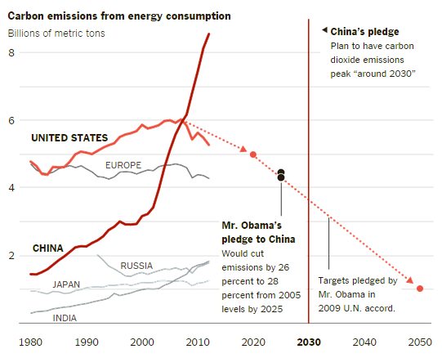
China’s Pledge to Reduce CO₂ Emissions
China’s president Xi Jinping, during a meeting with the President Obama on November 12th 2014 said: “China would brake the rapid rise in its carbon dioxide emissions, so that they peak around 2030 and then remain steady or begin to decline. And by then, (he promised), 20% of China’s energy will be renewable.”
Source: Energy Information Administration

Slide 9
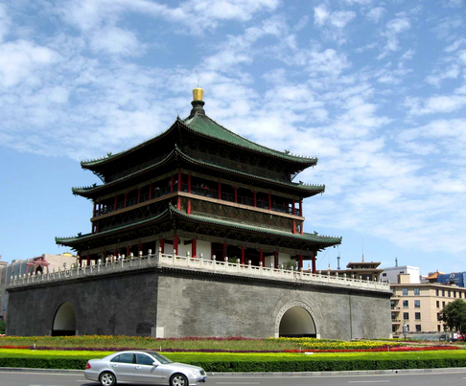
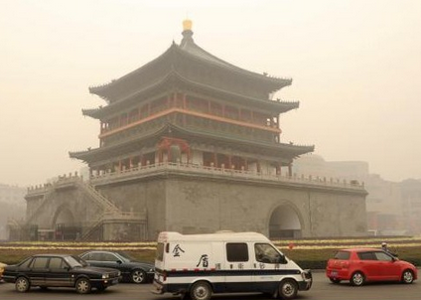
PM2.5
Particles with diameter of 2.5 micrometres or less are particularly deadly, with a 36% increase in lung cancer per 10µg/m³
Source: Ole Raaschou-Nielsen et al. (July 10, 2013), Air pollution and lung cancer incidence in 17 European cohorts: prospective analyses from the European Study of Cohorts for Air Pollution Effects (ESCAPE)". The Lancet Oncology 14 (9): 813–22.
Xi'an used to be
Xi'an now on a bad day

Slide 10
What’s in PM 2.5
The analysis of PM 2.5 varies but generally contains around:
26% of Organic matters (OM), 17% of NO₃⁻, 16% of SO₄²⁻, 12% of Crustal Elements and 11% of NH₄⁺
    Source: Beijing Municipal Environmental Protection Bureau, Analyzing the Source of PM2.5 in Beijing.
Carbon dioxide forms the anion in carbonates which comprise around 30% of all building materials.
Source: Estimate by Tony Thomas, Chief Engineer – Boral Australia
Syncarb can use both these unwanted outputs to produce carbonate and composite materials including carbonate fly ash and particulate construction materials

Slide 11

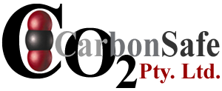

Green Cities
“There is a way to make our city streets as green as the Amazon Forest. Almost every aspect of the built environment from bridges to factories to tower blocks, and from roads to sea walls, could be turned into structures that soak up carbon dioxide – the main greenhouse gas behind global warming. All we need to do it is the change the way we make cement.” John Harrison
Pearce, F. (2002). "Green Foundations." New Scientist 175(2351): 39-40

Slide 12
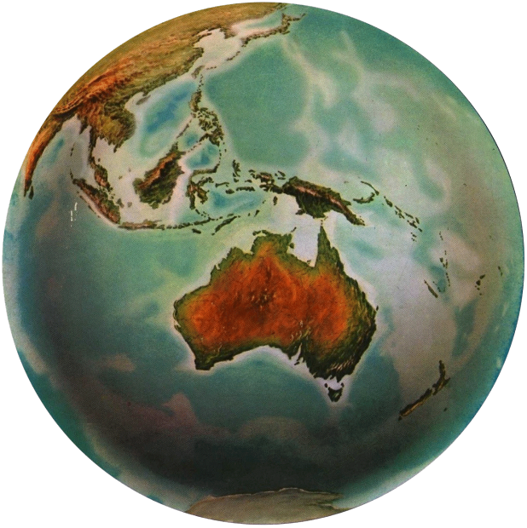

The Techno - Process
Biosphere
The techno-process describes and controls the flow of matter and energy through the supply and waste chains.
It results in moleconomic stocks and flows of energy and materials. If out of synch with earth systems these moleconomic flows have detrimental affects.
Geosphere
Detrimental affects on earth systems
Waste
Take
Move 700-800 billion tonnes
Use some 70 billion tonnes
Materials
Materials
Manipulate
Make and Use
Anthroposphere
To reduce the impact on earth systems new technical paradigms need to be invented and cultural changes evolve that result in energy and materials flows with underlying moleconomic flows that mimic or at least do not interfere with natural flows and that support rather than detrimentally impact on earth systems.

Slide 13
The Techno-Process
Extract, Process, Build, & Manufacture, Use, Dispose
Underlying Molecular Flows
Process,
Build
&
Manufacture
Extract
Dispose
or Waste
Use
Methane NOX & SOX
Heavy Metals
CO₂
etc.
NOX & SOX
Heavy Metals CO₂
etc.
Methane
NOX & SOX
Heavy Metals
CO₂
etc.
NOX & SOX
Heavy Metals CO₂
etc.
Embodied & Process Energy & Emissions
Lifetime Energy & Emissions
Embodied & Process Energy & Emissions
Process Energy & Emissions
Moleconomics
Is the study of the form of atoms in molecules, their flow, interactions, balances, stocks and positions. What we take from the environment around us, how we manipulate and make materials of what we take and what we waste result in underlying molecular flows that affect earth systems. These flows should mimic or minimally interfere with natural flows.

Slide 14
Detrimental Linkages of the Techno - Process
Detrimental Linkages that affect earth system flows
Take manipulate and make impacts
End of lifecycle impacts
There is no such place as “away”
Use impacts
in the Technosphere Utility zone
Materials are everything between the take and waste and affect earth system moleconomic flows. Energy drives the supply and waste chains
Greater Utility
Less Utility

Slide 15

Moleconomic Flows
Take → Manipulate → Make → Use → Waste
[ ←Materials flow→ ]
[ ← Underlying molecular flow → ]
If the underlying molecular flows are “out of tune” with nature there is damage to the environment
e.g. heavy metals, cfc’s, c=halogen compounds, methane and CO₂
Moleconomics is the study of the form of atoms in molecules, their flow, interactions, balances, stocks and positions. What we take from the environment around us, how we manipulate and produce energy and materials out of what we take and what we waste results in underlying molecular flows that affect earth systems. These flows should mimic, balance or minimally interfere with natural flows.

Slide 16
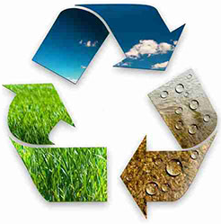
Changing the Techno-Process
Take => manipulate => make => use => waste
Driven substantially by fossil fuel energy with detrimental effects on earth systems.
Reduce
Re-use
Recycle
Innovate
Underlying moleconomic flows

Slide 17
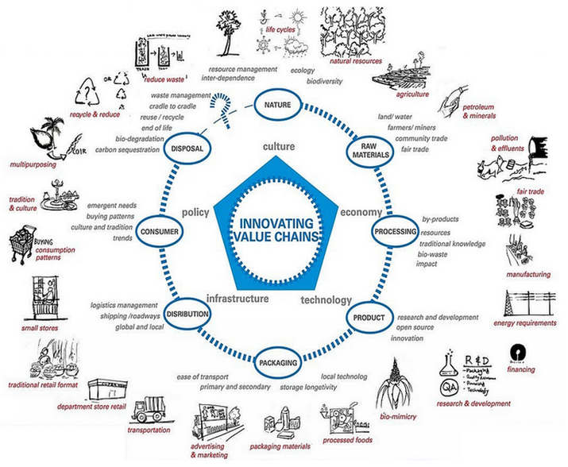
How?

Slide 18
Changing Technical Paradigms
  “By enabling us to make productive use of particular raw materials, technology determines what constitutes a physical resource”
  Source: Pilzer, Paul Zane, Unlimited Wealth, The Theory and Practice of Economic Alchemy, Crown Publishers Inc. New York.1990
Technology defines what is or is not a resource
By inventing new technical paradigms and re-engineering energy and materials that are economic to produce we can change the underlying molecular flows that are damaging this planet.
We must produce and use energy and materials that have underlying molecular flows that reverse, mimic or at least do not disrupt natural flows

Slide 19
Changing the Technical Paradigm
$
Increase in demand/price ratio for new technical paradigms due to cultural change.
Supply
Greater Value/for impact (Sustainability) and economic growth
ECONOMICS
Equilibrium
Shift
We must rapidly move both the supply and demand curves for sustainability
Demand
Increase in supply/price ratio for more sustainable energy/products/technologies due to technical innovation.
#
A measure of the degree of sustainability of an industrial ecology is where the demand for more sustainable technologies is met by their supply.

Slide 20
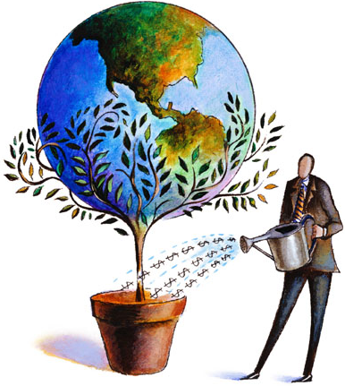
Technically Driven Change
Malcom Turnbull: “We have to recognise that the disruption that we see driven by technology, the volatility in change is our friend if we are agile and smart enough to take advantage of it.”
Alan Kay: “The best way to predict the future is to invent it.”
The Boston Consulting Group: “There are no old roads to new directions. ”
John Harrison: “New technology paradigms can solve many of the sustainability problems we have on spaceship earth. They are all connected.”
Al gore and David Blood: ”Sustainability investing is essential to creating long-term shareholder value.”

Slide 21
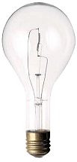


New Technical Paradigms >
Changed Techno-Process > Sustainability
Sand is now a Resource
Today almost everything that we don’t eat contains a silicon chip – cell phones, CD players, computers, hearing aids, TV’s and son and on.
Almost every car, appliance and toy has one or more silicon chips. The development of semiconductor physics is mirrored in the silicon devices made from sand.
Source: McWhan, Denis, "Sand and Silicon: Science that Changed the World" Oxford University Press, 2012
Light Globes - A Recent Paradigm Shift in Technology Reducing Energy Consumption
Light Globes in the last 10 years have evolved from consuming around 100 watts per 1700 lumens to less that 20 watts per 1700 lumens. As light globes account for around 30% of household energy this is as considerable saving.
Incandescent
Fluorescent
Led Light
100 watts
1700 lumens
25 watts
1700 lumens
<20 watts
1700 lumens

Slide 22
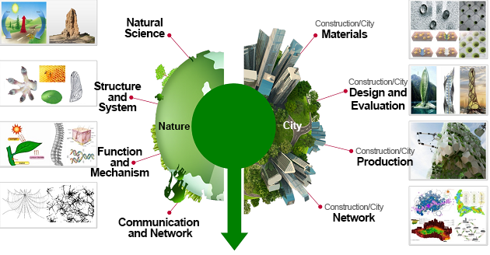
Biomimicry - Geomimicry
Biomimicry
Geomimicry
Technology
Paradigms
Marine creatures:
Sea water + CO₂ Shell Marine calcification
Human:
Sea water + CO₂ Homes Syncarb ?

Slide 23
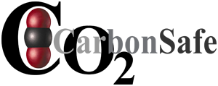
Materials and Energy in the Technosphere
(Mostly materials in this presentation. Energy covered in NEF-2015 presentation)

Slide 24
CO₂ Sequestration
Ocean-base sequestration
Geological sequestration
Inject carbon dioxide directly into the ocean at depth to form liquid CO₂ which will further react to form solid CO₂ clathrate hydrates.
Downsides:
High energy consumption because high injection pressures are required.
The equilibrium of the reaction will shift under high pressure to form carbonic acid which would exacerbate ocean acidification.
Deep-sea bacterial methanogens consume CO₂ to produce the greenhouse gas CH₄.
Inject carbon dioxide directly into underground geological formations.
Downsides:
Leakage due to percolation and geological events.
High injection pressures are required meaning high energy consumption.
Causes acidification which can damage the geological barrier (the same barrier prevents CO₂ escaping from underground)
Source: wiki

Slide 25
CO₂ Sequestration - Other Approaches
Technical Solution | Advantages and Practicality | Problems/Risks | Cost/ Profit?
Artificial accelerated weathering | Mimics natural weathering processes | High cost, significant time lags and possible production of chlorinated hydrocarbon compounds. | Involves the global commons and tinkering with nature. No profitable outputs.
Iron fertilisation to increase photosynthesis in the oceans | Increasing photosynthesis in the oceans has advantages including potential low cost. Downside is possible oxygen deficit and toxic algal blooms. | Potential legacies for future generations | Huge costs but possibly profitable depending on the price of carbon. Difficult to calculate value.
Injecting the air with particles to reflect sunlight (using aerosols) | Using aerosols would reduce the total energy reaching the earth but the cost and downside risks result in low overall benefits. | May aerosols such as sulfur dioxide used in the quantities required have several other downsides such as in the case of sulfur dioxide - acid rain. | Not likely given the quantities required.
Artificial accelerated weathering | Mimics natural weathering processes. | High cost, significant time lags and possible production of chlorinated hydrocarbon compounds. | Involves the global commons and tinkering with nature. No profitable outputs.
CO2 fixation by algae | Works well enough | Works well enough. Bio reactors are still being developed. | Would cost a lot of money
Reacting carbon dioxide with sodium bicarbonate or other minerals | Works well enough | Problem is making the sodium bicarbonate in the first place and then possibly having to get rid of the sodium ion out of material made. | Would cost a lot of money
For more complete list please visit our TecEco website: http://www.tececo.com/sustainability.solutions_global_warming.php

Slide 26
Mineral Sequestration
Mineral sequestration is based on the reaction of CO₂ with suitable mineral ores to form insoluble carbonates.
The reactions are quite simple:
Wollastonite:
CaSiO₃ + CO₂ CaCO₃ + SiO₂ + 90 kJ/molCO₂
Olivine:
Mg₂SiO₃ + 2CO₂ 2MgCO₃ + SiO₂ + 89 kJ/molCO₂
Serpentine:
Mg₃Si₂O₅(OH)₄ + 3CO₂ 3MgCO₃ + 2SiO₂ + 2H₂O +64 kJ/molCO₂
All of these reactions are exothermic, which means they can occur under room temperature and atmospheric pressure (25ºC, 1Bar).
The final products of the process can be either dumped as landfill or used as construction materials (see figure).
They can be used as fillers with rMgO binder made using the Syncarb process.

Slide 27
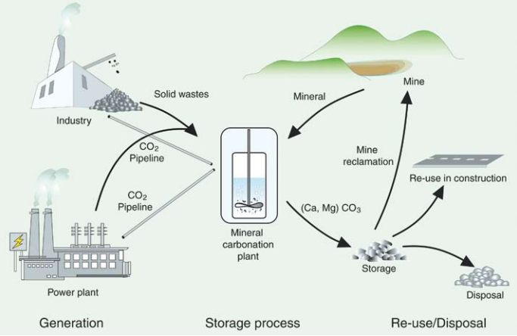
Mineral Sequestration and Industrial Uses of CO₂
Source: IPCC special report on Carbon dioxide Capture and Storage

Slide 28
Limitations of Mineral Sequestration
Although mineral carbonation can occur naturally, the rate of reaction is too slow to be practical.
There are two approaches to speed the process up:
Activating the mineral to make it more labile and reactive, such as, heat treatment at 650ºC and ultrafine grinding.
Utilising additives or catalysts in solution.
The methods above have been studied and tested. The results show that they are either too expensive or energy intensive to be applied in practice¹.
The raw materials used for the process are also quite restricted.
1. Juan Carlos Abanades, IPCC Special Report on Carbon dioxide Capture and Storage, Chapter 7, Mineral carbonation and industrial uses of carbon dioxide.

Slide 29
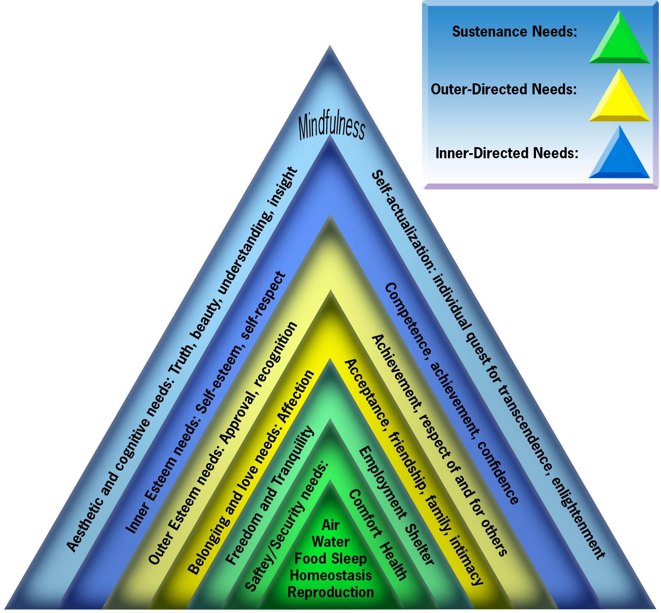
Adding Value to Emissions
Maslow's hierarchy of needs as reconstructed by Alysion.org
By making CO₂ and other emissions needed by us we can incorporate them in our economic system and add value.
Source: alysion.org/acres
We can profitably internalise CO₂ and particulates in the economy.

Slide 30
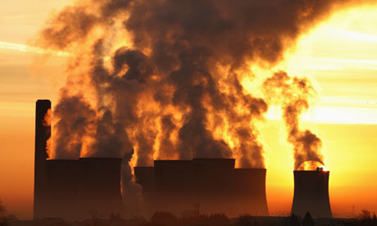
Syncarb
The Syncarb process is:
Simple
Scalable
Has low up front capital costs
No environmental impacts
Easily implemented
Industrially symbiotic and deployable over a wide geographical area
Produces saleable products including fresher water for insatiable markets.
An opportunity for power companies to use waste energy to solve their emissions problem in a flexible scalable process
The SynCarb process produces large quantities of carbonates including magnesium carbonates such as nesquehonite (MgCO₃.3H₂O) from waste magnesium cations (Mg++) such as found in oil process water, desalination waste water, bitterns and brines (step 1).
Nesquehonite is a commodity and can be sold directly, converted into other saleable magnesium compounds or calcined in our Tec-Kiln without releases (step 2) to make dead burned, caustic and reactive magnesia (rMgO) all of which are also commodities. rMgO is the key to bonding composite materials of the future made from a wide range of organic and inorganic wastes because it propagates polar bonding. It is also the basis of TecEco Cements. The CO₂ emissions from step 2 can be recycled back into step 1 resulting in the precipitation of more magnesium carbonates.
Acidification is prevented by using the balancing anion to produce acid, composites and aggregates and possibly fertilizer if we succeed in making ammonia in a process we are also working on.

Slide 31
Why Sea/Brine Water and CO₂?
Over 30 Gt carbon dioxide are released to the atmosphere every year, just as computers are now made from sand can we use it?
People think of CO₂ as a waste, John Harrison sees it as a resource!
We can make a profit if by changing the technical paradigms so CO₂ becomes a resource. We can use it as a raw material to make construction materials in a way that mimics nature.
The average concentration of magnesium ions in seawater is around 1.3 mg/L.
Seawater as a resource is virtually unlimited!
Waste brines such as oil process water, coal seam gas water, gas water and de-sal waste water contain high percentages of magnesium and can be used as an inputs in the Syncarb process
There is a wide range of potential products. Our first target will be building & construction products that also use other organic and inorganic wastes.
Because of the polar bonding propagated by magnesium, all manner of wastes both organic and inorganic can be incorporated.
The world of the future will be a world of composites made in this way.
We can create a new industrial ecology without outputs that are damaging to the global commons. Without CO₂ emissions, many brines and a wide range of what are currently considered wastes.

Slide 32
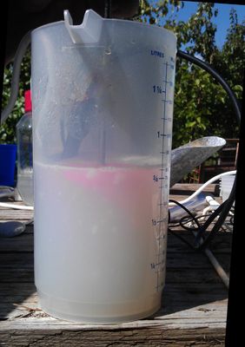
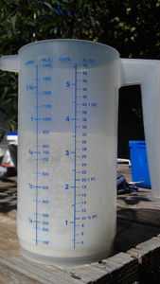
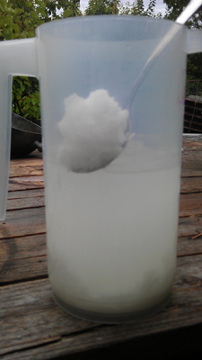
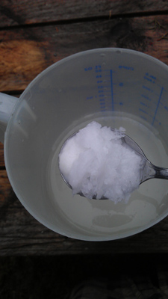
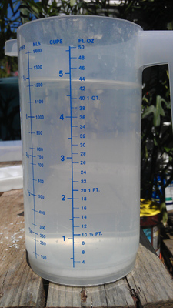
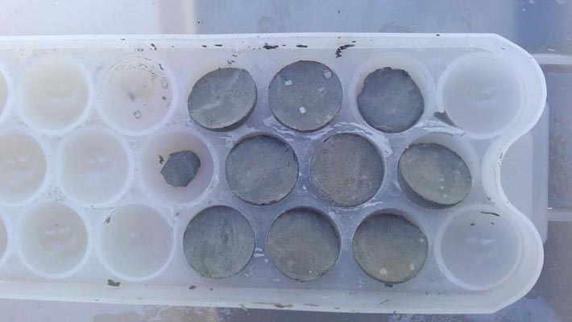
In the Laboratory
Precipitation from bitterns. The waste from salt manufacture and mainly MgCl₂
Colloidal at first
Microcrystallites
Massive
Close up
Aggregate made from precipitate and fly ash
Precipitate from seawater

Slide 33
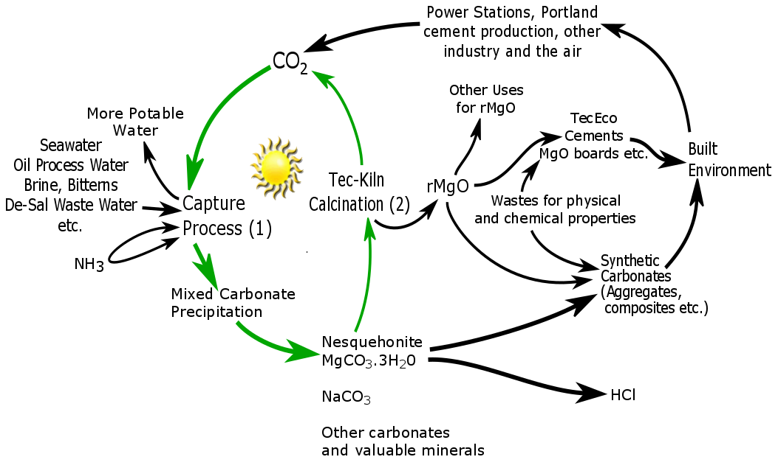
We Know We Can Separate Precipitates

Slide 34
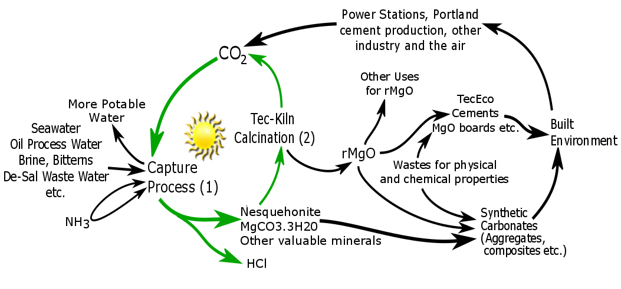
Syncarb as it is Now
If we could make ammonia without releases of CO₂ we could produce ammonium chloride which is a fertilizer
If we could separate the precipitates in the wet phase the process would be a lot more profitable

Slide 35
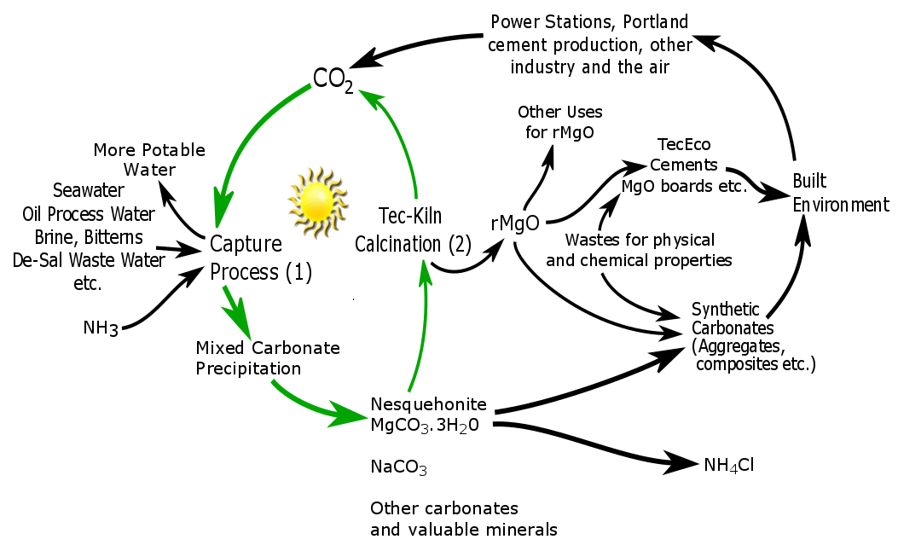
What next for Syncarb
Further Processing to separate

Slide 36
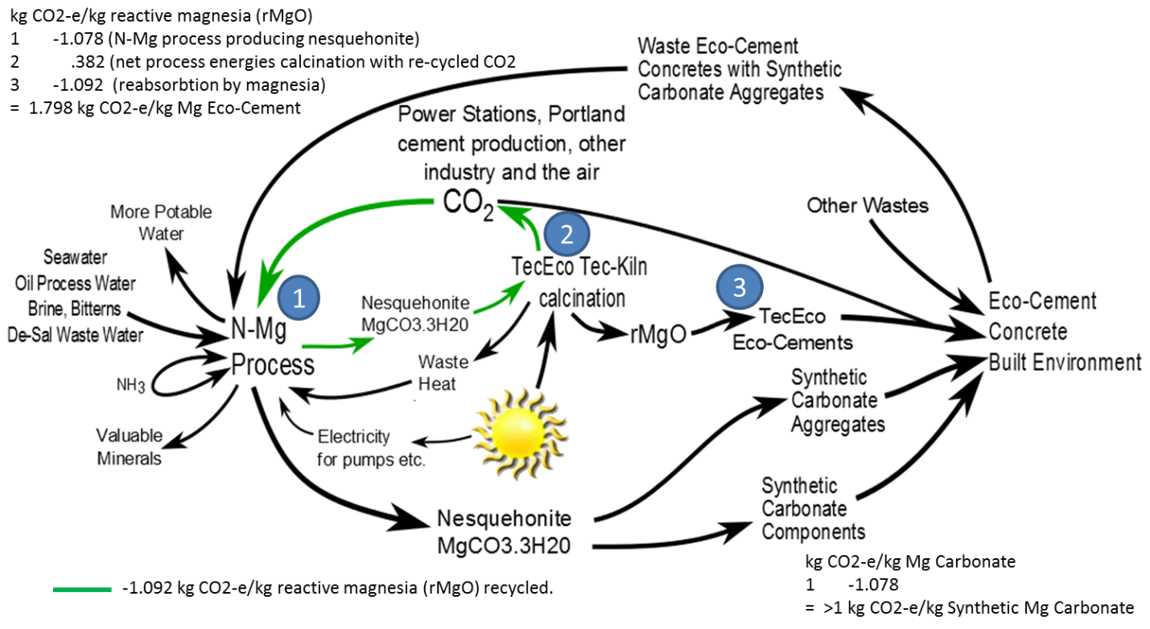
Syncarb Gaia Engineering Thermodynamics

Slide 37
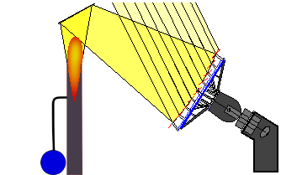
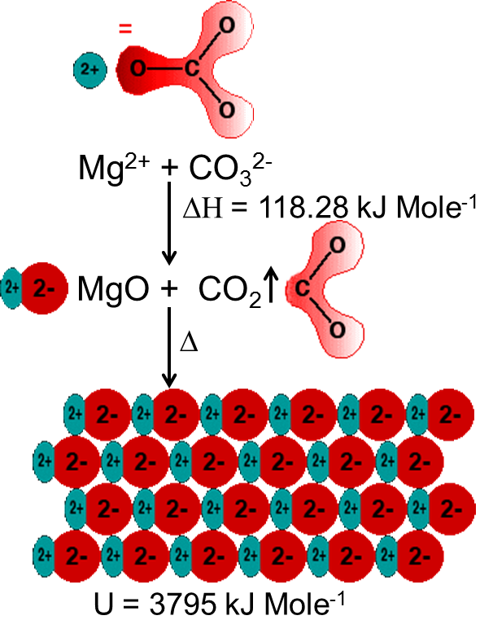
The Tec-Kiln
An obvious future requirement will be to make cements without releases so TecEco are developing a top secret kiln for low temperature calcination of alkali metal carbonates and the pyro processing and simultaneous grinding of other minerals such as clays.
The TecEco Tec-Kiln has no releases and is an essential part of TecEco's plan to sequester massive amounts of CO₂ as man made carbonate in the built environment .
The TecEco Tec-Kiln has the following features:
Operates in a closed system and therefore does not release CO₂ or other volatiles substances to the atmosphere.
  The CO₂ produced will be recycled in the N-Mg process.
Can be powered by various potentially cheaper non fossil sources of energy such as intermittent solar or wind energy and is energy smart.
Grinds and calcines at the same time thereby running 25% to 30% more efficiently.
Produces more precisely definable product. (Secret as disclosure would give away the design)

Slide 38
Separation of Syncarb Products & the Properties of Water
Water is a polar covalent molecule, it has a slight positive and slight negative charge on opposite ends. Two hydrogens are attached to oxygen and the molecule forms a 109.5º bend.
Because water is a bent, partially polar molecule it bonds to other polar molecules, has statistical structure, cohesion and surface tension.
Polar bonding strength is affected by both Kaotrophes and cosmotrophes as well as dissolved gases.
Water disassociates into H₃O+ and OH- depending on ions present in solution and through a mostly proton wrenching process solvates (dissolves) minerals.
The success of Syncarb as a process depends on our understanding of the unique properties of water and how we can manipulate them.

Slide 39
Syncarb - Adding Values to Wastes
The Syncarb process is a new game changing mineral sequestration process.
Instead of using minerals, the raw materials are CO₂ and waste brine which contains large amount of Mg²⁺, Ca²⁺ and Na⁺ ions.
CO₂ adds significant value to brines compared to evaporative precipitation.
Compared with normal mineral carbonation:
Low input costs – raw materials
Olivine: $65-145/ton, Serpentine (chrysotile): ~$1500/ton, Wollastonite: $120-140/ton
Waste brine water is a pollutant and people will pay us to use it?
Low capital cost – transport
Transportation of minerals from mining site to operation sites consumes labor and energy.
Syncarb inputs are transported in pipes by pumping.

Slide 40
Syncarb - Adding Values to Wastes
All the first stage outputs from Syncarb are commodities such as calcium and magnesium carbonates, sodium bicarbonates (?), gypsum etc.
Secondary products include reactive magnesia (rMgO) and Tec and Eco - Cements already widely used around the world in the building and construction industries.
Water produced by the process can be used for irrigation, gardening, showering, washing etc. With secondary processing for drinking water.
Ammonium chloride hopefully produced by process is mainly used as a nitrogen source in fertilizers. Other than that, it also can be used as a flux for metal coating, an expectorant for cough medicine, a food additive for food industry and so on.
The Syncarb process utilizes a variety of industrial wastes and converts them into profitable and widely used materials for construction and for the start of the supply chain in other industries.
Syncarb reverses the waste output of industrial ecologies that damage the environment by adding value to them as new inputs in the supply chain

Slide 41
Syncarb - Adding Values to Wastes
The production of reactive magnesia in the Syncarb process enables TecEco cement technologies John Harrison invented years ago to become viable.
Tec and Eco Cements are ideal for bonding organic and inorganic wastes to make composites and are ideal for immobilizing and utilizing toxic and hazardous wastes such as fly and bottom ash iron slags, red mud etc.
The wastes incorporated which can either be organic or inorganic further enhance the physical and chemical properties of the composite products produced which initially will mostly be for the building and construction industries.
Because it propagates polar bonding magnesium is essential for the manufacture of composites of the future that will utilise a wide range and high volume of wastes in their composition.

Slide 42
Syncarb Summary
Inputs
Outputs
CO₂
Bitterns
Waste brines
Oil process water
Gas process water
Coal water
Coal seam gas water
De-sal waste water
etc.
NH3
Mg Carbonates => TecEco cements
Ca Carbonates
Na Carbonates
Na Bicarbonates
Gypsum
Other salts
HCl or NH4Cl
Fresher water => potable water
Syncarb is an opportunity for integrated power generators to utilise excess energy to economically solve the CO₂ problem by producing valuable products.

Slide 43
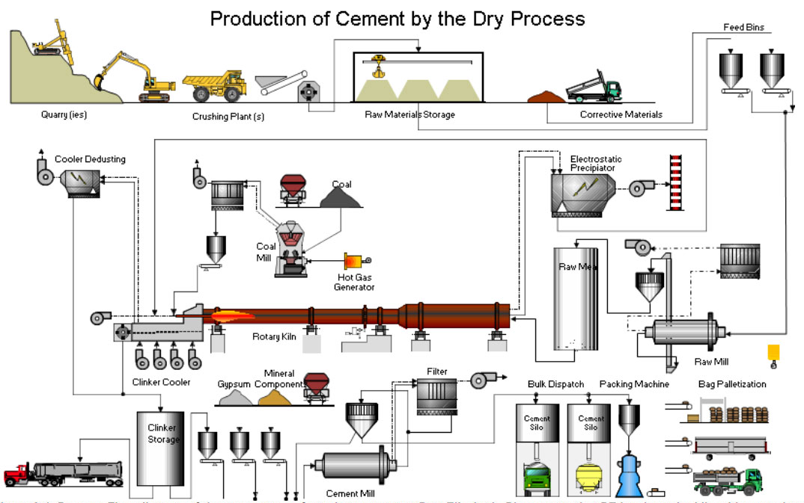
Why the Concrete & Building Materials Industry?
Source: http://www.engineeringintro.com/uncategorized/cement-manufacturing-process/
Cement manufacture is a very energy intensive process and results in the production of large amounts of carbon dioxide. Current world production is around 4.2 billion tonne.
Aggregates are used in concrete, road making etc. and world production is over 48 billion tonne.
Source: http://www.concreteconstruction.net/aggregates/global-demand-for-construction-aggregates-to-exceed-48-billion-metric-tons-in-2015.aspx
Other Statistics: U.S. Geological Survey, Mineral Commodity Summaries

Slide 44
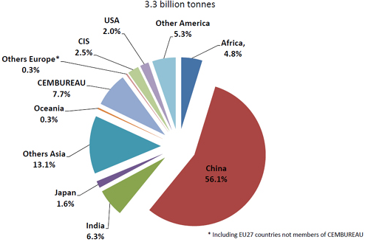
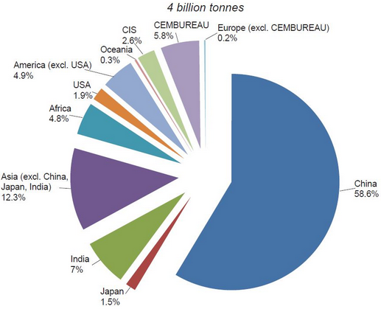
Cement and Aggregate in China
China has the largest cement production of any country in the world. The number is still growing, due to economic and population growth.
2010
2013
Source: British Geological Survey, Mineral Profile, Cement Raw Materials, November 2005.
Najabat Ali, The Greenhouse Gas Emissions Produced by Cement Production and Its Impact on Environment: A Review of Global Cement Processing, 2015.
Aggregates are unknown but a similar story to the above. The world market is 48 billion tonne. In China it is probably more than 25 billion tonne

Slide 45
TecEco-Cements
Tec-Cements (5-20% MgO, 80-95% OPC)
contain more Portland cement than reactive magnesia. Reactive magnesia hydrates in the same rate order as Portland cement forming Brucite which uses up excess water reducing the voids:paste ratio, increasing density and possibly raising the short term pH.
Reactions with pozzolans are more affective. After much of the Portlandite has been consumed Brucite tends to control the long term pH which is lower and due to it’s low solubility, mobility and reactivity results in greater durability.
Other benefits include improvements in density, strength and rheology, reduced permeability and shrinkage and the use of a wider range of aggregates many of which are potentially wastes without reaction problems.
Eco-Cements
Eco-Cements are blends of one or more hydraulic cements and relatively high proportions of reactive magnesia with or without pozzolans and supplementary cementitious additions. They will only carbonate in gas permeable substrates forming strong fibrous minerals such as lansfordite and nesquehonite. Water vapour and CO₂ must be available for carbonation to ensue.
Eco-Cements can be used in a wide range of products from foamed concretes to bricks, blocks and pavers, mortars renders, grouts and pervious concretes such as our own permeacocrete. Somewhere in the vicinity of the Pareto proportion (80%) of conventional concretes could be replaced by Eco-Cement.

Slide 46

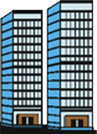


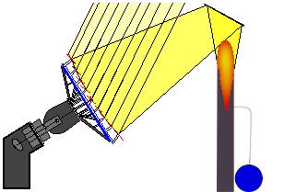
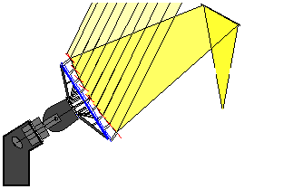
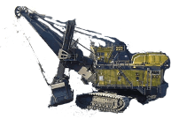


Gaia Engineering
Inputs:
Atmospheric or industrial CO₂,
brines (e.g. de-sal and process waste water, other wastes
Outputs:
Carbonate building materials, NH₄Cl, fresher water.
Gaia Engineering is an industrial ecology that delivers profitable outcomes whilst reversing underlying undesirable moleconomic flows from other less sustainable carbon emitting processes.
Carbonate building components
CO₂
Syncarb
Solar or solar derived energy
CO₂
CO₂
Tec-Kiln
CO₂
Eco-Cement
rMgO
MgCO₃.3H₂O
Extraction Process
Coal
1.30 gm/l Mg
.412 gm/l Ca
Carbon or carbon compounds
Magnesium compounds
Fossil fuels
Oil
www.tececo.com www.gaiaengineering.com

Slide 47
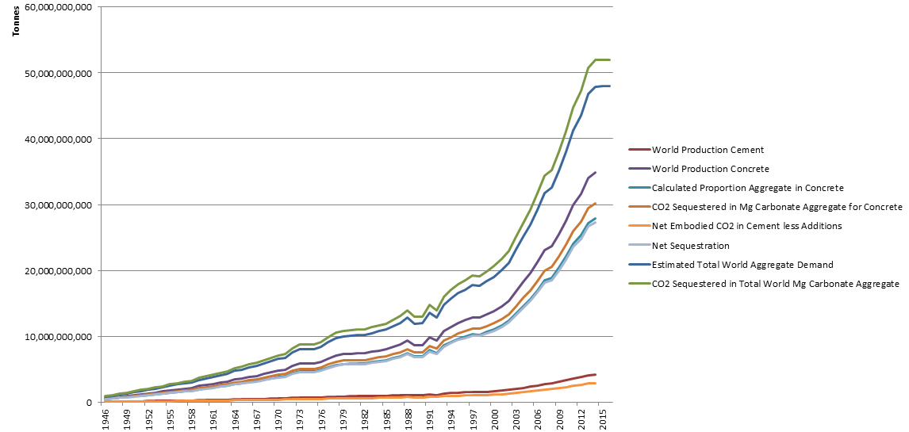
Syncarb Sequestration
Syncarb implemented widely is the solution to global warming the world needs as it profitably sells synthetic carbonate into huge insatiable markets.
Current Global Emissions in this Range
Global demand for construction aggregates exceeds 48 billion tonne.
Source: http://www.concreteconstruction.net/aggregates/global-demand-for-construction-aggregates-to-exceed-48-billion-metric-tons-in-2015.aspx
Other Statistics: U.S. Geological Survey, Mineral Commodity Summaries

Slide 48
Syncarb Sequestration if only output is Aggregate for Concrete - Assumptions
Assumptions
Percentage by weight of cement in concrete | 12.00%
Percentage by weight of MgO in Tec-Cement | 9%
Percentage by weight Ca(OH)2 in cement | 29%
% of Ca(OH)2 in concrete that carbonates | 10.00%
Proportion cement that is flyash and/or GBFS | 20%
1 tonne Portland Cement | 0.867 | Tonnes CO2
Proportion concrete that is aggregate | 80.0%
CO2 captured in 1 tonne aggregate | 1.084 | Tonnes CO2
Net CO2 sequestration 1 tonne rMgO (N-Mg route, 1 complete recycle) | 0.000 | Tonnes CO2
CO2 captured hydration and carbonation of 1 tonne CaO (in PC) | 0.000 | Tonnes CO2
Source global production statistics : USGS web site.
Note that there will be a trade off between aggregate quality and amount of other waste used in the formulation such as fly ash and mine tailings both of which unfairly are rated as having lower embodied energies and emissions

Slide 49

Global Emissions
Source: http://www.c2es.org/docUploads/global-co2-historical-3.png

Slide 50

Anthropogenic Sequestration Using Syncarb Gaia Engineering will Modify the Carbon Cycle
CO₂ in the air and water
Cellular Respiration
Cellular Respiration burning and decay
Decay by fungi and bacteria
Photosynthesis by plants and algae
Gaia Engineering, (Syncarb and TecEco-Cements)
Limestone coal and oil burning
Organic compounds made by heterotrophs
Organic compounds made by autotrophs
Consumed by heterotrophs (mainly animals)
More about Gaia Engineering at
http://www.tececo.com.au/simple.gaiaengineering_summary.php

Slide 51
Conclusions
Polluting the global commons must stop altogether. We must stop throwing energy, matter and dangerous molecules away. There is no such place.
Interactions with the biosphere-geosphere must be sustainable
The technosphere must be contained within itself with 100% recycling.
Recycling everything including CO₂ is technically possible.
As energy drives the supply and waste chains (the techno-process), with efficient recycling we can reduce the embodied energy & emissions of materials.
There is a huge potential resource in renewable energy especially of unused wind and solar given their significant flux.
Flexible value adding processes compliment the development of renewable energy and materials by providing a use that may otherwise be wasted if in over supply because of prevailing conditions.
Syncarb is flexible process and a game changer in relation to the above because it reverses much of the supply and waste chains in the techno-process.
Solving global warming is only possible economically. It will not happen because it is necessary or right.

Slide 52

I have spent a lifetime inventing new technology paradigms.
Please help me turn my ideas for a better, more profitable
and sustainable future into invoices before it is too late.
Aubrey John W Harrison
Carbonsafe Pty Ltd
497 Main Road
Glenorchy
Tasmania 7010 Australia
Ph/Fax: +61 (0)3 62492352
Mob: +61 (0)413993911
Email: john.Harrison@carbonsafe.com
谢谢聆听
Xiexie Ling ting

